Slide 1

Notes:
# <p id = "small-caps">13. &nbsp; Epilogue </p> [Hengfeng Wei (魏恒峰)](https://hengxin.github.io/) hfwei@nju.edu.cn Dec. 21, 2022

Slide 2


Slide 3
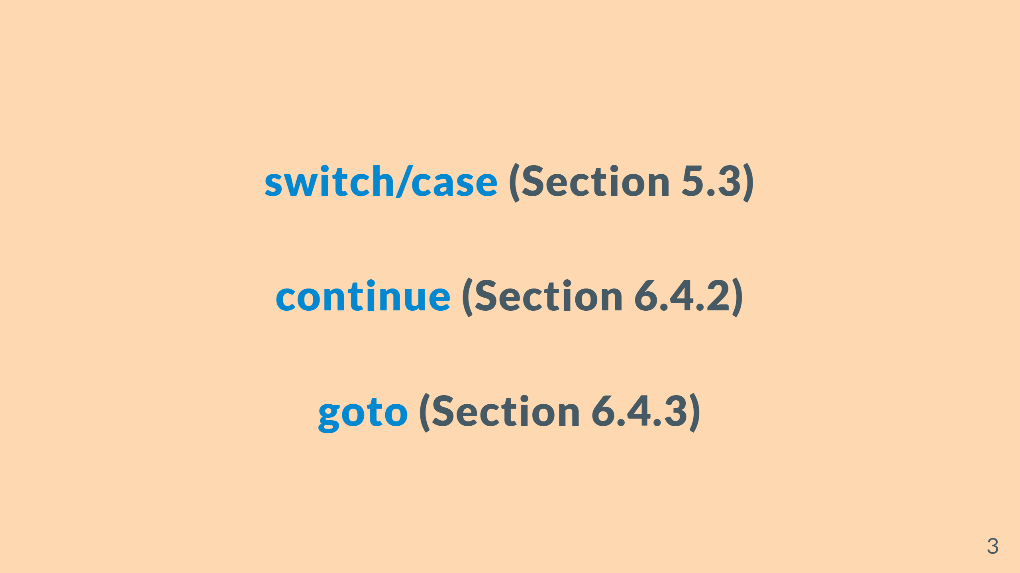

Slide 4
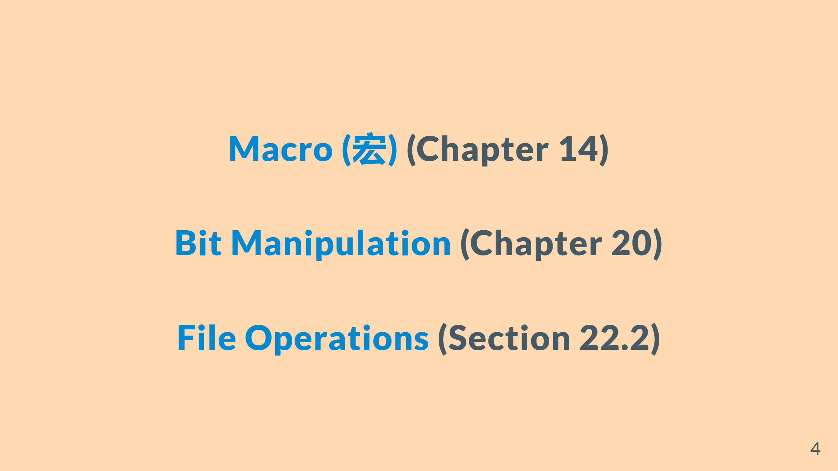

Slide 5

Notes:
![w:500](figs/stay-tuned-tv.jfif)

Slide 6


Slide 7


Slide 8
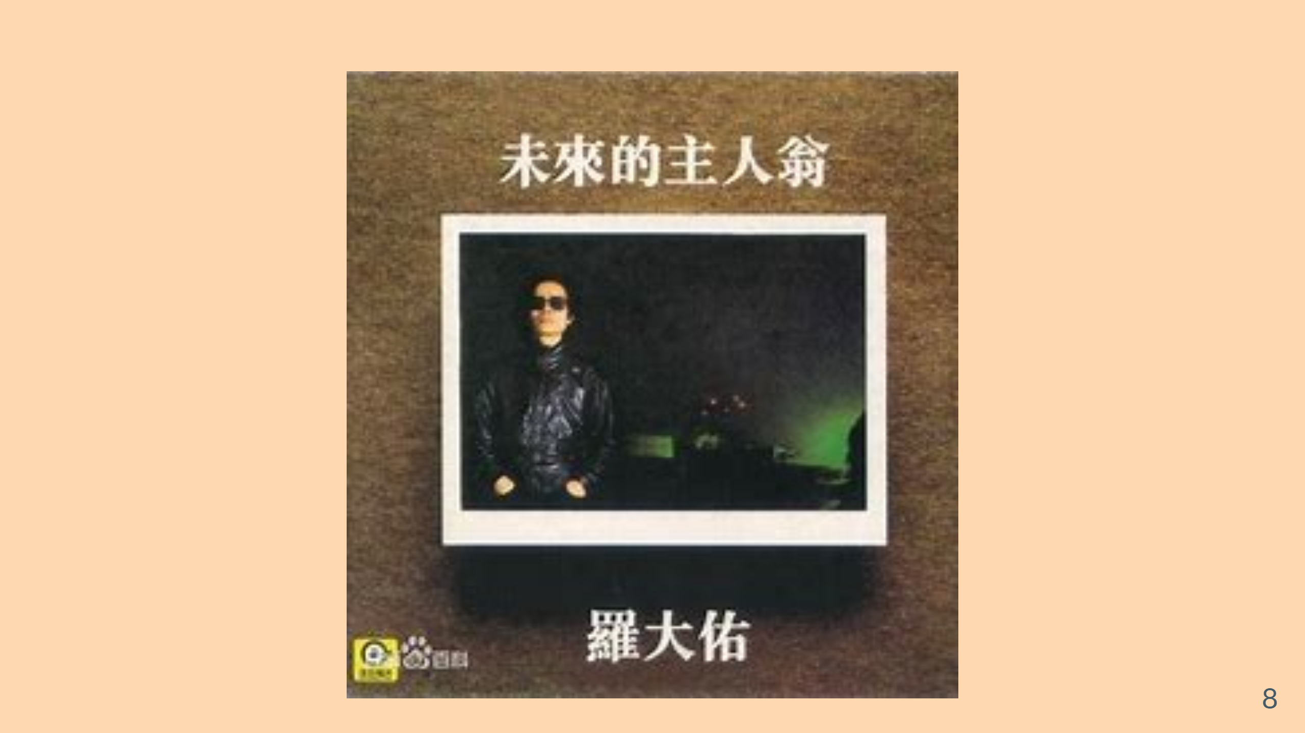

Slide 9


Slide 10


Slide 11


Slide 12


Slide 13


Slide 14


Slide 15


Slide 16


Slide 17


Slide 18
